Slide 2

Communication and technology company
560 employees in 4 countries
Norway
Denmark
Sweden
Iceland
Ukraine
Slovakia
Main office in Oslo
Office in Bergen as well.
On of Norway’s Top 25 most innovative companies five years in a row
Who are we?

Slide 3

TEST IN ITERA
46 people in UA and SA
10 people in Norway
2 people in Denmark
13 people working with TA
Areas we have competence in:
test management
test automation (js, Java, .NET, mobile, API)
test advisory
security testing
performance testing
mobile testing
accessibility testing

Slide 4

TEST automation
IN3240/in4240 – Gjesteforelesning med itera

Slide 5
WHAT IS TEST AUTOMATION
“Test automation is the use and development of special software
(separate from the software being tested)
to control the execution of tests and the comparison
of actual outcomes with predicted outcomes.”
Notes:
This is a little bit meta, but we are writing code to test the code.
Many of you have probably heard about unit testing. Unit tests are one type of automated tests, but test automation is more than just unit testing.
GUI testing and test automation origin:
First automated tests - Testers got bored repeating the same tests over and over again. So what they started to do was to record where they clicked and what text they wrote. This was done by recording the pixels that were clicked. This worked great for a time and the testers saved a lot of time using the automated tests. But then the systems changed, the buttons were moved. Someone had decided the application needed a fresh look. All the tests broke, because the pixels clicked were no longer what they were before. But they decided it was worth it to record the tests again. And steps were taken to make it easier to record and maintain.
Then later, everyone finally got the new monitors everyone had been asking for. Since the screen resolution was increased, the pixels were not in the same place at all. Now every step of every test failed.
The managers looked questionably at the testers that went out to the dumpster and picked up their old screens...
This story illustrates that test automation can be a powerful tool, but if we don’t do test automation correctly it can be very time consuming to maintain the tests.

Slide 6

Why Test Automation?
Quick feedback on errors
Quicker testing and deployment
Regression testing
Testing on multiple browsers and devices
Generation and validation of test data
Repetitive tests that are similar
Accurate calculations
Documentation
Notes:
* Automated tests should be so fast that you can run them all the time. This means that you can run the tests every time you save for example. Then, every time you save you get instant feedback and you would know if one of the previous lines code you wrote broke the code. This makes it easier and quicker to fix bugs.
* While not all tests can be automated, automating some of your tests will let you test faster. Faster testing leads to shorter time to market.
* If all your systems have automated tests, then when you make changes in one systems, you can run the tests for all the other systems to make sure that everything still works together. Or if you are upgrading versions, then nothing should break, but you can run all your tests to be certain.
* Many test automation frameworks allow you to write one test, and then run it on multiple browser or devices. This can save a lot of time.
* Automated tests can be used to generate and/or validate test-data. So even if the tests are run manually, having the computer validate the test data will help the manual testers complete their tests faster.
* If humans are told to do the same boring tasks over and over again, they will take shortcuts and make mistakes. A computer will never be bored of running the same tests and will never take clever shortcuts. The computer will do what you programmed it to do.
* For tests that require accurate calculations humans will make human errors. The computer will never get computations wrong.
* Some frameworks allows you to write tests that are written in such a way that they also function as documentation of the system.

Slide 7

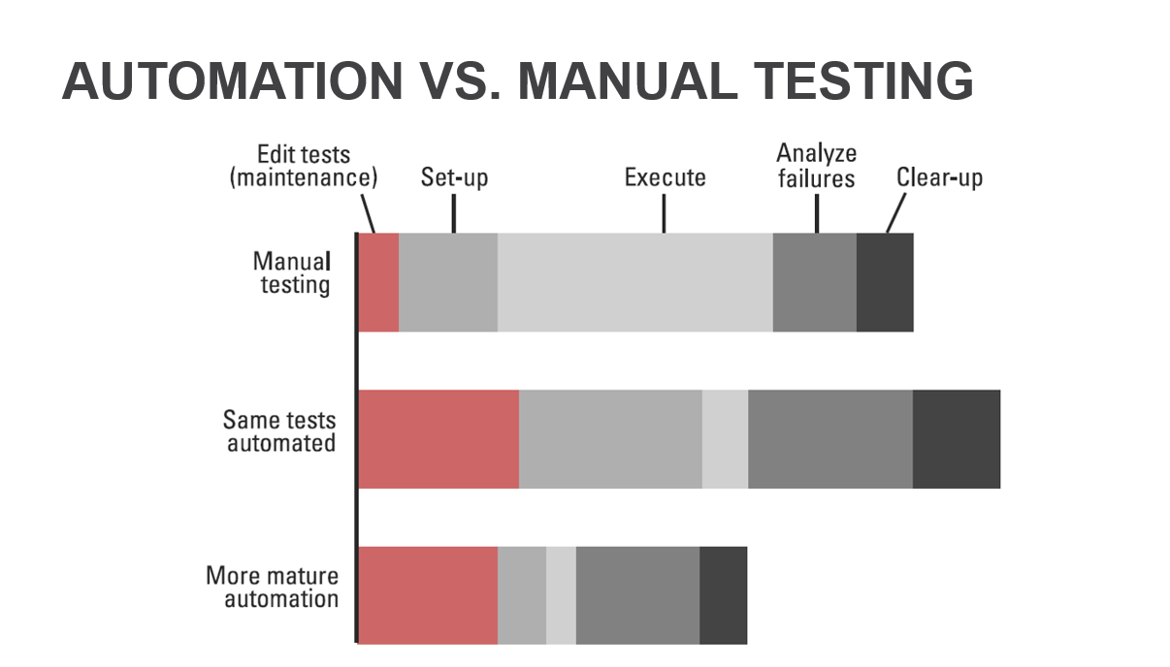
When not to use test automation
Systems that changes often and drastically
Systems that are on their way out
Small or short projects
Notes:
So by now you are probably thinking that automated tests sounds great, but unfortunately there are some drawbacks.
Even if the test automation is done properly, all automated tests require maintenance. And what is really scary is that test automation done poorly will require so much maintenance that it will not save you time.
So, what are the scenarios where we should avoid test automation?
* If your system under test changes drastically often, then many of your tests will break to often and it is not worth it.
* Systems or applications that will be decommissioned is a bad use case for test automation. Automated tests needs to be run many times to gain value.
* Short projects are bad for the same reason that we do not want to automate on systems that will be shut down. We will not run the tests enough times to gain value. For small project it might be easier to test manually then to invest a lot of time in test automation.

Slide 8
LEVELS OF TEST AUTOMATION
Manual
Performed by
Trust in the whole system
Trust in single components
GUI
Integration
Unit
Test Automation Engineers
Developers
Notes:
When building up test automation, it is done in layers to form a pyramid.
The first layer is unit testing. Unit tests test a single component. Unit tests are fast and when they fail you know exactly where in the code the error is because the error will be in that component. Unit tests are written by developers as part of the development process. Unit tests form the bottom layer in the test pyramid. Of all our tests we want most of them to be unit tests and that is the reason unit tests form the widest layer in the pyramid.
The second layer are integration tests, here we test the interaction between components or systems. Integration tests are slower than units tests and take more time to develop. Therefore we want fewer integration test than unit tests, so this layer is not as wide. Also, we do not want to write an integration test for something that could have been tested with a unit test.
The third layer is graphical user interface testing. Here we write tests that simulate user actions with clicks and inputs. These tests are much slower than the two previous kinds and are more difficult to maintain. Therefore GUI tests form the peak of the pyramid and we will have even fewer of those. We absolutely do not want to write GUI tests where we could have written a unit test or integration test. But, having a test that uses all systems at the same time can be powerful and we gain a lot of trust in the system. Since GUI tests are closer to user action, more knowledge about test and what is a good testcase is required. GUI tests are often written by test automation engineers that knows test and development or by testers and developers in collaboration.
At the top of the pyramid we have manual testing. Some tests are to expensive to automate and manual testers can find bugs the automated tests will not catch.

Slide 9
Developer
Who should do test automation?
Test-automation engineer
Tester
Little or no test knowledge
Development expert
Can set up framework
By participating in test automation effort, test automation will be part of development and ownership will be shared in team.
Strong test knowledge
Strong development knowledge
Can set up framework
Engineer will too often become the only one with ownership to the test automation effort.
Test expert
Little or no development knowledge
Will struggle to set up a stable framework
Stronger collaboration with developers and ownership of the automated tests.
Notes:
Lets look at what the different roles bring to test automation and what they lack.
Developers know a lot about development, but might have poor knowledge of testing. For testers it is opposite, they know testing, but not development. An test-automation knows both, but is more of an jack-of-all-trades.
Testers might be able to set up some test automation framework, but they will struggle to set up something that is scalable and easy to maintain. Developers with their technical expertise will do this a lot better. TA engineers will also be able do this, but might require help from developers on project specific challenges.
When developers set up test automation as part of the development cycle, knowledge and ownership will be shared. If testers do test automation, knowledge and ownership will be shared. It is critical that testers get help from developers when they face difficulties with the automation. If the developers do not spend time the testers will in the long term fail to maintain the automated tests. Most team will only have one TA engineer, teams should take precautions that the TA engineer does not take sole responsibility and ownership of the automated tests. If they do, then if that persons leave, no one else will know how to maintain the automated tests and the tests will die.

Slide 10

More on test pyramid
Manual
GUI
Integration
Unit
Notes:
The test pyramid approach is to build up the test coverage in layers. There we have the most unit tests which are fast, easy to maintain and tells you exactly where the error is. By having more tests lower in the pyramid, we need fewer the higher we come in the pyramid. Which is great because the higher we come, the slower and more difficult the tests will be.
Lets compare the pyramid to another approach, the icecream approach. Lets imagine a team that only does manual testing and want to start doing test automation. They will still have a lot of manual tests, the top of the icecream. They will have many GUI tests as they try to automate their manual test cases. The icecream is not stable. Without all the component tests, the GUI tests and integrations tests will be difficult to debug and you will have only slow tests. And if the tip of your icecream breaks all you icecream will fall out.

Slide 11
Evolution of approaches
Capture & Playback
Scripted and Modular
Data driven
“Scriptless” automation
Smart Framework
Notes:
1st gen - The main advantage was it allowed tests to be run unattended for several hours each day. Also it made automation of regression testing possible. Tests were easily broken because even a minor change to the AUT required that the test to be recorded again manually. It was overall expensive at the time of first execution. Maintenance overhead was much more. Data hardcoded.
2nd gen - It was the addition of Scripting to the Capture/Playback tools. These scripts were highly customized or modified. Most people were of the view that testing has become software development project as to create a new test process meant to create a new script. It required considerable technical knowledge, expertise and support. Maintenance of ever-increasing libraries of automation scripts became a great challenge. Rise of IDE-like editors in automation tools.
3rd gen - In this approach Test data is held separately. The test library is the test scripts. Capture replay may (or may not) be used as an input to the script-building process but more use is now of driver scripts. One advantage is that the data can be set ready by testers without depending on automation engineers. Now data can be created in huge amounts (as per the requirements) and in many possible variations to test the AUT robustly. These previous points greatly divide the problem into two parts so that it can be resolved amicably but maintenance issues are still there not now only of the scripts but also of data.
4th gen - Smart Framework engines (Keyword driven) are used in this case to replace scripting for the major part. With this the maintenance needed due to revisions in the test is greatly reduced. The cost and time of test design, automation, and execution is also greatly reduced with this approach. Keyword-driven Framework: Tables on a spreadsheet determine the action of a test script based on a library of functions for an assigned keyword.
5th gen - Most frameworks evolve into this over time and multiple projects. Smart Framework engines too are used here but somewhat refined to offer what may be called business rules-based test design and “scriptless” automation through the use of GUI views, templates etc.
A simple definition of Scriptless Test Automation can be, “an approach that helps users automate their tests without having to script or code using any programming language”.

Slide 12
Common types
Data-driven
Hybrid
Model based
Process-driven
Actions are combined into highl level functions which are then used to create the scenario
Abstractions which do not use code to represent a scenario, but components linked into model representing flow
Test data held in separate files and defines which input is used in control scripts
Keyword-driven aka table/action-driven
Test data files additionally hold definitions of actions and they are used by one main control script
Several are used simultaneously

Slide 13

Test automation in the sdlc
Integrated part of the software development life cycle
Continuous process
Quicker release process with automated tests
Notes:
How does test automation fit into the software development cycle?
Setting up test automation, writing new tests, maintaining old test is a continuous process and every team that wants to do test automation should integrate it into the SDLC.
This will require some investment, but if it is done correctly it will lead to faster development, quicker releases and shorter time to market.

Slide 14
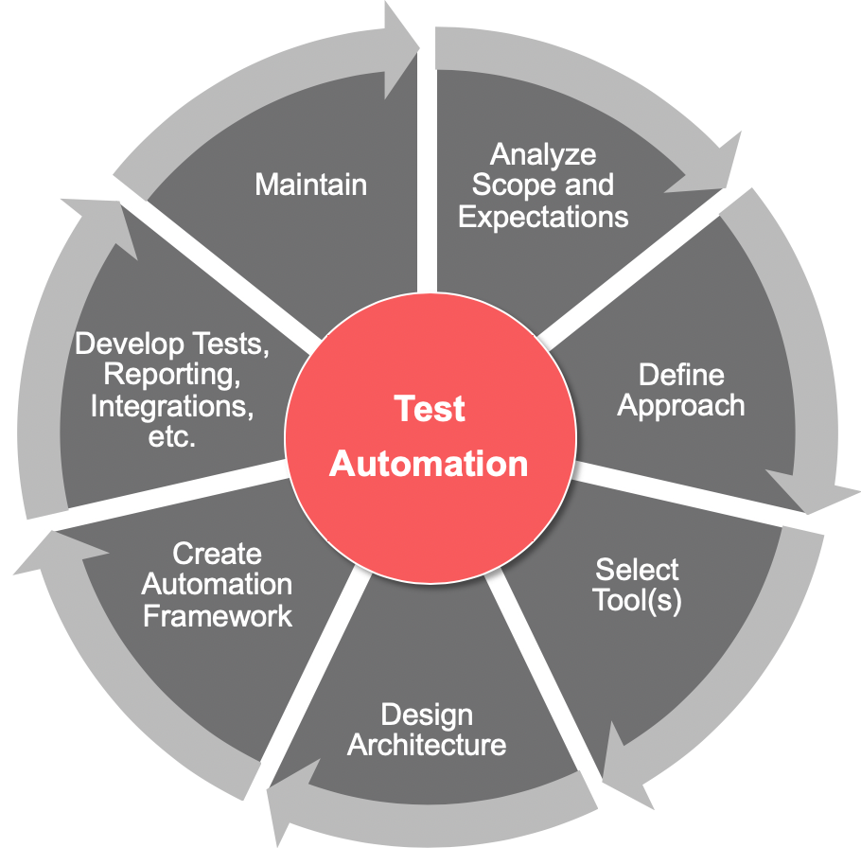
TEST AUTOMATION process
Analyse scope and expectation
Define approach
Select tool(s)
Design architecture
Create automation framework
Develop tests, reporting, integrations, etc.
Maintenance
Notes:
Test automation process is usually done in following order:
1. Define scope and expectations
* Going through the scope for test – what should be automated? What should one have as expectations for the automations?
2. Define approach
* During this fase, we inspect which part of the system we should start automation with, and how to cover the scope that was defined in the previous step
3: Select tool(s)
* Here we perform an analysis and choose the best suited tools and technologies to use for the automation.
4: Design architecture
* We set up the architecture for test-automation, this is a separate architecture from the arcithecure of the actual solution/product. The goal is to set up an architecture that is scalable and easy to maintain.
5: Create automation framework
* During this phase, we construct the framework which all the tests are based on.
* In later iterations, this step will be used to update frameworks in order to incorporate new tests and maintain the older ones.
6: Develop tests, reporting, integrations etc.
Here, we write the code for the tests to be automated. It is also a big focus to setup reports that will collect results from the test executions.
We also execute running of test-suites that were created
7: Maintenance
Finally, this phase pertains the maintenance of existing tests, maintenance is important when the system is changing or when there is a change in the test-data

Slide 15
PROCESS WITH CONTINUOUS TESTING
Planning
Implementation
Finish
Activities
Development
Review of backlog items and plan features
Development of features with deploys on QA env
Final deploys
Building packages
Manual Testing
Requirements testing
Risk analysis
Creation of test cases
Test Data preparation
Functional testing
Bug registration
Test Automation
Add available integrations
Technical assessment
Update TA Framework
Create auto tests
Finalize tests
Analyze execution results
Maintenance incl. test automation framework and auto tests, ongoing execution of selected automated regression test suites on CI
Notes:
Testing is not something that happens at the end of development. The same is true for test automation. This figure illustrates how testing and test automation is done in parallell through what could be one sprint.
In the planning phase the developers will review backlog and which features they should develop. Tester will do requirement testing and analysis of acceptence criteria. Those working with test automation will investigate if their framework is capable of automating the new features. Meybe the framework needs new features or integrations against new systems.
In the implementation phase, the developers will develop features. The testers will create test cases and prepare testdata for testing and test automation. Those working with test automation will update framework as needed and develop new automated tests.
In the final phase, developers will prepare for deployment to production environment and fix bugs found by the testers and automated tests. Testers will execute their tests. The automated tests will be run and the tests report analyzed.
In my previous description I have assigned a role to each activity, but it will help the team greatly if the team members are flexible and will help with other activities than their specielty. For example if all testcases have been written, testers can help write auto tests. Or if the only task remaining is to run all functional tests, than all team members can help with testing.

Slide 16

Frameworks

Slide 17

HoW to choose your framework?
No silver bullet
Paid or open source?
Does your framework have continued support?
Is the community active?
Consider using a test automation framework that was made for your chosen development framework
Which framework do your team have experience in?
Notes:
There is no silver bullet, no framework is always be the best one. All frameworks have their advantages and disadvantages.
Consider if you want to use an open source framework or a framework you have to pay for. Open source can be great, if the communtiy is active. Then it is easy to google solutions or ask questions. You might even collaborate if you have a great idea. Paid services can be better, but it can be hard to experiment and see if this is the correct solution for your team. Especilly if the framework only has limited trial offerings. And it costs money.
Looking for testing frameworks that are made especially for your development framework is often a good idea. For example for front end development, ghest is made specifically for react and protractor is made for angular. It will often be easier to learn and will have usefull features.
Other than thay, if someone in your team has experience with a framework, choosing that framework will make it easier to get started.

Slide 18






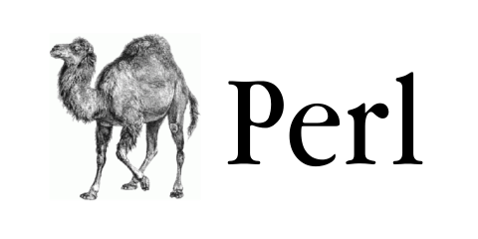
What language can I use?
Notes:
Most languages can be used for test automation. When developing your automated tests it is possible to use a different language than what you application is written in, but we recommend to use the same language.

Slide 19







DIFFERENT FRAMEWORKS
Serenity BDD
Protractor
Cucumber
RobotFramework
NightWatch
WebDriveIO
RedWood
Notes:
There are many different frameworks for test automation. They each have their own strengths and weaknesses. The one we will focus on today is cypress.io

Slide 20

What is Cypress?
JavaScript-based framework for end-to-end testing
Front-end testing tool built for the modern web
Free & Open-Source (MIT License)
Notes:
End-to-end testing
Testing an application workflow from beginning to end (aims to replicate real user scenarios)
Also allows you to write integration- and unit tests
Built on top of Mocha, Cypress is a tool for reliably testing anything that runs in the web browser, enabling asynchronous testing
React, Vue, etc. (if it runs in the browser, you can test it)
MIT License, sustainable open source. Do what you wish (fork it, add new stuff)

Slide 21

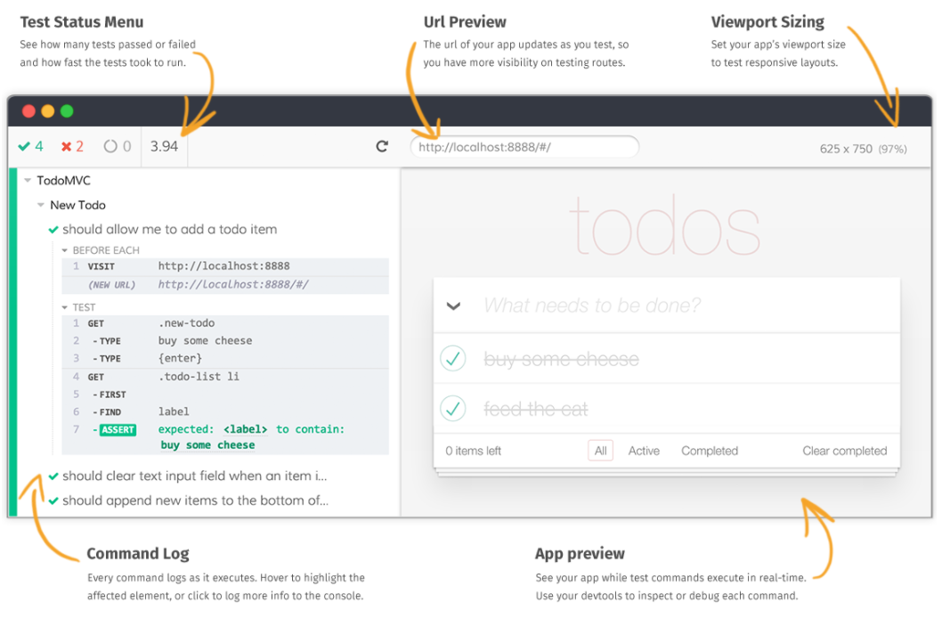
Features
Time travel
Automatic waiting
Stubs and clocks
Screenshots and Videos
Cross browser Testing
Notes:
Time travel: Cypress takes snapshots as your tests run, able to see exactly what happened at each step
Automatic waiting: automatically waits for commands and assertions before moving on (don’t need to add wait or sleeps to your tests)
Stubs and clocks: Verify and control behavior of server responses, or manually control your application’s date and time
Screenshots and videos: View screenshots taken automatically on failure, or videos of your entire test suite
Cross browser testing: Run tests within Firefox, Chrome, and Edge locally and optimally

Slide 22
Cypress vs selenium
Cypress
Selenium
Executes in the browser
Open source
Automatic waiting
All-in-one package
Strong inbuilt test runner with automatic error reporting and possibility for time travel debugging
Executes in a process outside of browser
Open source
Manually add wait/await/sleep
Usually combined with other frameworks/plugins (Web driver, TestNG, etc.)
Have to build test report yourself
Notes:
The most commonly used framework for test automation is Selenium. Selenium is much older, established solution than Cypress and it is the benchmark all other frameworks compares themselves against, while Cypress have been gaining popularity and traction over the last few years
Cypress executes the vast majority of its commands inside the browser, so there is no network lag. Commands run and drive your application as fast as it is capable of rendering.
They are both open source
Cypress will automatically wait for your application before moving on. You don’t need to fuss with manual waits or retries. Cypress automatically waits for elements to exist and will never yield you elements that have been detached from the DOM. (This is eliminated by executing in the browser vs. outside, Cypress automatically waits for DOM elements to appear)
Cypress: all-in-one package (either from node or direct download). Selenium: very bare in itself, need to download web driver for browser testing, TestNG for script test cases and import test data, other plugins for test report generation etc.
Cypress ultimately controls the entire automation process from top to bottom, which puts it in the unique position of being able to understand everything happening in and outside of the browser. This means Cypress is capable of delivering more consistent results than any other testing tool.

Slide 23
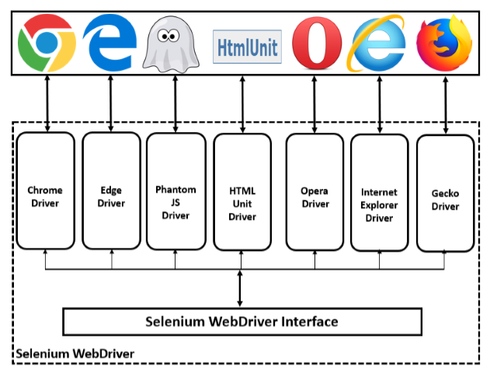
SELENIUM – WEB DRIVER
WebDriver is a web automation framework that allows you to execute your tests against different browsers
Notes:
SPO
Hvorfor Selenium Web Driver
Direct communication with the web browser
No need for a server
Quick execution
Support iPhone and Android testing
Mange, kanskje de fleste programvareprogrammer i dag, er skrevet som web-baserte applikasjoner som kjøres i en nettleser. Effektiviteten av å teste disse applikasjonene varierer mye mellom bedrifter og organisasjoner. I en tid med svært interaktive og lydhøre programvareprosesser hvor mange organisasjoner bruker en form for Agile-metodikk, blir testautomatisering ofte et krav til programvareprosjekter. Testautomatisering er ofte svaret. Testautomatisering betyr å bruke et programvareverktøy til å kjøre repeterbare tester mot programmet som skal testes. For regresjonstesting gir dette denne responsen.
Selenium er en samling av verktøy for automatisering av browserfunksjoner over flere plattformer. Selenium kan således ha flere bruksområder. Et av disse er automatisering av browsertest.
Selenium WebDriver, er et grensesnitt tidligere Selenium Remote Control krever større forståelse for scripting og utviklerspråk, men kan brukes over flere miljøer. WebDriver er egnet til å lage automatiserte regresjonstester.

Slide 24
Test NG
Well suited for Eclipse and Java
Well suited for beginners
TestNG supports use of Maven
TestNG enable us to easily:
Script test cases
Import testdata
Take screen shots and report on errors
Make cohesive summary and reports when running a test suite consisting of many tests.
Can be used for more than GUI testing
Notes:
Maven is a software project management tool that makes it easier, to share, compile and download dependencies for a project
TestNG can also be used for unit testing, functional testing, end-to-end testing, integration testing and more.

Slide 25
Let’s get practical
Notes:
You DO NOT have to follow the steps I'm doing on your machine
All the things I'm doing now, you will get instruction files for.
The only attention I need you, is on my screen.

Slide 26
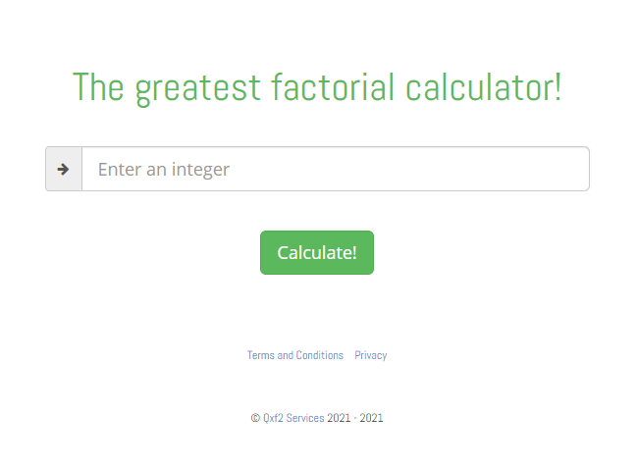
Factorial calculator
A solid test generally covers 3 phases:
1. Set up the appliation state
2. Take an action
3. Make an assertion about the resulting application state
Visit a webpage
Query for input field and type
Query for button and click
Assert the content on the page
https://qainterview.pythonanywhere.com/

Slide 27
FindElement
<a href=”page2.html“ class=“buttoncls” name=“button" id="link">Click here</a>
Finding WebElement by using various locators in WebDriver
Using Id
Using name
Using tagName
Using linkText
Using className
Using cssSelector
Using xpath
WebElement element = driver.findElement(By.id("link"));
WebElement element = driver.findElement(By.name("button"));
WebElement element = driver.findElement(By.tagName(“a"));
WebElement element = driver.findElement(By.linkText("Click here"));
WebElement element = driver.findElement(By.className(“buttoncls"));
WebElement element = driver.findElement(By.cssSelector(“a#link")); → css Tag and ID selector
WebElement element = driver.findElement(By.cssSelector(“a.buttoncls")); → css Tag and class selector
Notes:
Özkan:

Slide 28
Practice Exercise 1 - Textarea
Launch new browser
Open URL https://itera-qa.azurewebsites.net/home/automation
Type Name, Mobile number, Email address, Password, Address (Use ID locator )
Click on Submit button (Use Name locator)
Close browser

Slide 29
Practice Exercise 1 - SOLUTION
import org.testng.annotations.Test;
import org.testng.annotations.BeforeClass;
import java.util.concurrent.TimeUnit;
import org.openqa.selenium.By;
import org.openqa.selenium.WebDriver;
import org.openqa.selenium.chrome.ChromeDriver;
import org.testng.annotations.AfterClass;
public class Exercise1 {
WebDriver driver;
@BeforeClas
public void beforeClass() {
driver = new ChromeDriver();
driver.manage().timeouts().implicitlyWait(10, TimeUnit.SECONDS);
driver.manage().window().maximize();
driver.get("https://itera-qa.azurewebsites.net/home/automation");
}
@Test
public void textarea() {
driver.findElement(By.id("name")).sendKeys("Ola Nordmann");
driver.findElement(By.id("phone")).sendKeys("+4712345678");
driver.findElement(By.id("email")).sendKeys("test@test.no");
driver.findElement(By.id("password")).sendKeys("itera");
driver.findElement(By.id("address")).sendKeys("Nydalsveien 28, 0422 Oslo, Norway");
driver.findElement(By.name("submit")).click();
}
@AfterClass
public void afterClass() {
driver.close();
}
}

Slide 30
Practice Exercise 2 - CheckBox & Radio Button
Launch new browser
Open URL https://itera-qa.azurewebsites.net/home/automation
Select the Gender(Use ID locator)
Check the Check Box "Tuesday" and "Friday" for category ‘Which days of the week are best to start something new?'(Use ID locator)
Close browser

Slide 31
Practice Exercise 2 - SOLUTION
import org.testng.annotations.Test;
import org.testng.annotations.BeforeClass;
import java.util.concurrent.TimeUnit;
import org.openqa.selenium.By;
import org.openqa.selenium.WebDriver;
import org.openqa.selenium.chrome.ChromeDriver;
import org.testng.annotations.AfterClass;
public class Exercise2 {
WebDriver driver;
@BeforeClass
public void beforeClass() {
driver = new ChromeDriver();
driver.manage().timeouts().implicitlyWait(10, TimeUnit.SECONDS);
driver.manage().window().maximize();
driver.get("https://itera-qa.azurewebsites.net/home/automation");
}
@Test
public void checkBoxRadioButton() {
driver.findElement(By.id("male")).click();
driver.findElement(By.id("tuesday")).click();
driver.findElement(By.id("friday")).click();
}
@AfterClass
public void afterClass() {
driver.close();
}
}

Slide 32
When and HOW to locate element by XPATH
Every element does not have an id -­‐> static id, unique name, unique link text. For those elements we need to build xpath to find and then perform actions on them.
Whatever we use to find an element, id, name, xpath -­‐> It should always be unique. It should only find one matching node unless we want to capture a list of elements.
Difference between single ‘/’ or double ‘//’
Single slash ‘/’ anywhere in xpath signifies to look for the element immediately inside the parent element.
Double slash ‘//’ signifies to look for any child or nested-­‐child element inside the parent element.
Syntax: //tag[@attribute='value']
Notes:
Özkan
//a[contains(text(),Click here')]
Syntax: //tag[contains(attribute, ‘value’)]
Syntax: //tag[starts-with(attribute, ‘value’)]
Syntax: xpath-to-some-element//parent::<tag>
Syntax: xpath-to-some-element//preceding-sibling::<tag>
Syntax: xpath-to-some-element//following-sibling::<tag>

Slide 33
Practice Exercise 3 - XPATH
Launch new browser
Open URL https://itera-qa.azurewebsites.net/home/automation
Select the Radio button (2 years) for category Years of experience in test automation (locate elements by Xpath method.)
Check the Check Box ‘Selenium Webdriver’ and TestNG for category ‘Which automation tools/frameworks do you use?'(locate elements by Xpath method)
Close browser

Slide 34
Practice Exercise 3 - SOLUTION
import org.testng.annotations.Test;
import org.testng.annotations.BeforeClass;
import java.util.concurrent.TimeUnit;
import org.openqa.selenium.By;
import org.openqa.selenium.WebDriver;
import org.openqa.selenium.chrome.ChromeDriver;
import org.testng.annotations.AfterClass;
public class Exercise3 {
WebDriver driver;
@BeforeClass
public void beforeClass() {
driver = new ChromeDriver();
driver.manage().timeouts().implicitlyWait(10, TimeUnit.SECONDS);
driver.manage().window().maximize();
driver.get("https://itera-qa.azurewebsites.net/home/automation");
}
@Test
public void checkBoxRadioButtonXpath() {
driver.findElement(By.xpath("//label[@for= '2years']")).click();
driver.findElement(By.xpath("//label[@for= 'selenium']")).click();
driver.findElement(By.xpath("//label[@for= 'testng']")).click();
}
@AfterClass
public void afterClass() {
driver.close();
}
}

Slide 35
PageObject
What happened when the application under test changes?
How to make automated tests that are easy to maintain?
Notes:
Svend-Peder:
Ta inn objektorientert tankegangen
Vi har nå laget et script. Se for deg at du har laget mange tester 10, 50, 100 ? Design kommer å sier at knapper skal flytte på seg => ok. Men hva vi skal endre kontakt skjema fra et input felt for navn til to. Testen vår vil kræsje. Hvis vi har en metode for å fylle ut navn trenger vi kun endre den og alle testene kjører. Løsning pageObjects

Slide 36
@FindBy
WebElement firstName = driver.FindElement(By.name(“firstname”));
@FindBy(name = “firstname”);
WebElement firstName;
Notes:
Svend-peder

Slide 37
PageObject test case
public class Exercise1WebElement2 {
WebDriver driver;
@FindBy(id = "name")
WebElement nameElement;
@FindBy(id = "phone")
WebElement phoneElement;
@FindBy(id = "email")
WebElement emailElement;
@FindBy(id = "password")
WebElement passwordElement;
@FindBy(id = "address")
WebElement addressElement;
@FindBy(name = "submit")
WebElement submitElement;
public Exercise1WebElement2(WebDriver driver)
{
this.driver = driver;
PageFactory.initElements(driver, this);
}
public void fillInForm(){
nameElement.sendKeys("Ola Nordmann");
phoneElement.sendKeys("+4712345678");
emailElement.sendKeys("test@test.no");
passwordElement.sendKeys("itera");
addressElement.sendKeys("Nydalsveien 28");
submitElement.click();
}
}
public class Exercise1PageObject2 {
WebDriver driver;
Exercise1WebElement2 exercise1;
@BeforeClass
public void beforeClass() {
driver = new ChromeDriver();
driver.manage().timeouts().implicitlyWait(10,TimeUnit.SECONDS);
driver.manage().window().maximize();
driver.get("https://itera-qa.azurewebsites.net/home/automation");
}
@Test
public void textarea() {
exercise1 = new Exercise1WebElement2(driver);
exercise1.fillInForm();
}
@AfterClass
public void afterClass() {
driver.close();
}
}
Notes:
Özkan -
Parameters:
driver The driver that will be used to look up the elements
Driver som vil bli brukt til å slå opp elementene
page The object with WebElement and List<WebElement> fields that should be proxie
Objektet med WebElement og List <WebElement> -felter som skal proxied.

Slide 38
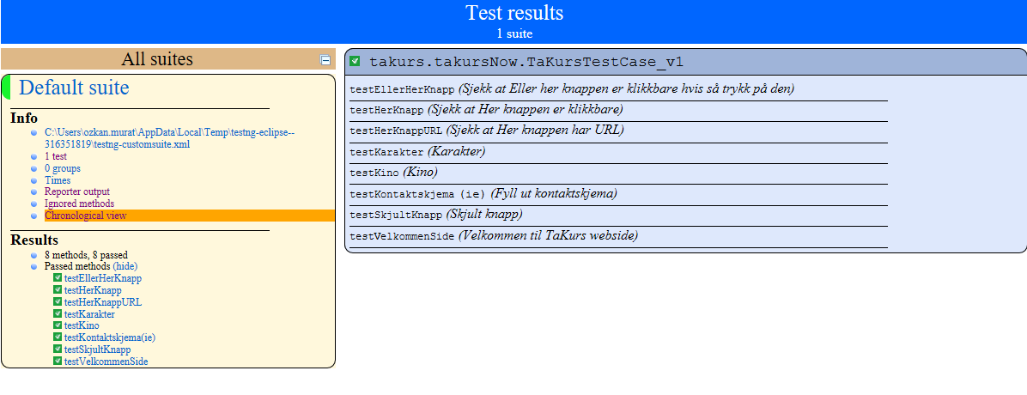
TestNG: HTML-report exampel
Notes:
özkan

Slide 39
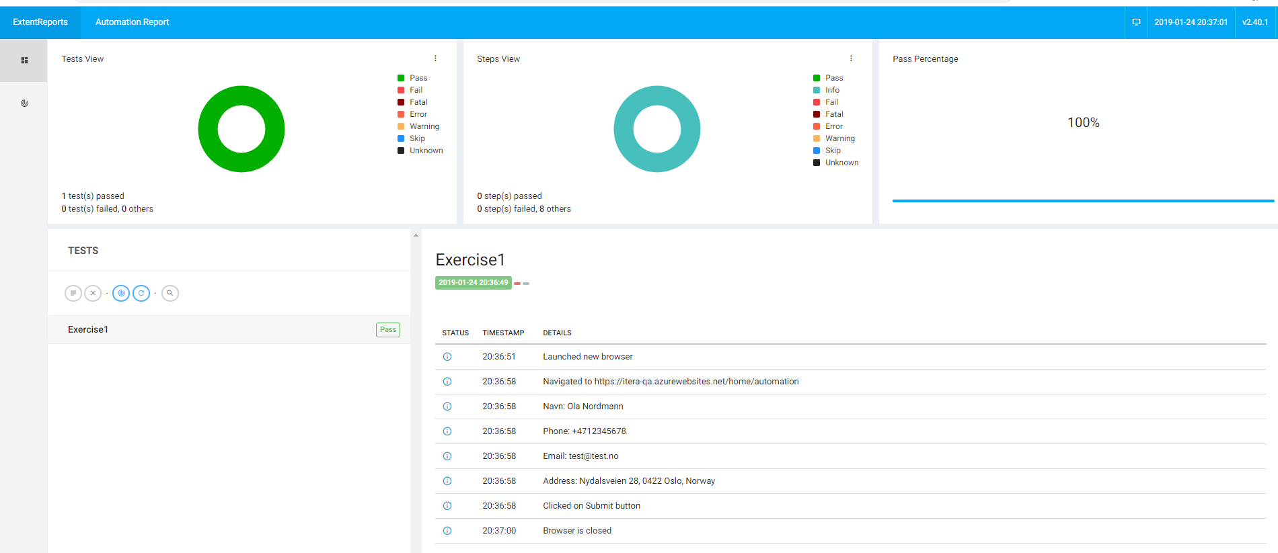
Extent reports: HTML-rapport
Notes:
özkan

Slide 40
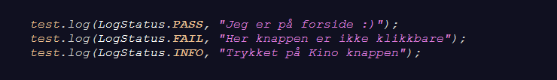
HTML-rapport
Notes:
Özkan:

Slide 41

How to start?
Have clear boundries
When should the tests run?
Jenkins / teamcity
How many tests?
Begin with something small
Only make tests that have value
Experiment
Kill all that don’t have value
Unit/integration testing > End-to-end testing
Notes:
•Ha klare rammer – Have clear boundies
•Når skal testene kjøre? – When should the tests run?
•Jenkins / teamcity
•Hvor mange tester skal man ha? – How many tests?
•Start med noe lite – Begin with something small
•Lag kun tester som gir Verdi – Only make tests that have value
•Eksperimenter - Experiment
•Drep alt som ikke gir Verdi – Kill all that don’t have value
•Unit/integrasjonstesting > E2E testing – Unit/integration testing > End-to-end testing

Slide 42


